Slide 1
PARTICLE FILTERS
Particle Filters : two words.
Filter : a procedure that estimates parameters (state) of a system.
Particles : a set of randomly chosen weighted samples used to approximate a pdf.

Slide 2




Outline
1
Introduction
2
General Bayesian Framework
3
Particle Filters
4
Visual Tracking
5
Conclusion
Module Image - I2S

Slide 3
Introduction
Recall on Estimation Theory
What Is A Particle Filter ?
Applications in Computer Vision

Slide 4
Introduction
Particle Filters : two words
Filter : a procedure that estimates parameters (state) of a system.
Particles : a set of randomly chosen weighted samples used to approximate a pdf.
Estimation
Estimation is the process by which we infer the value of a quantity of interest, x, by processing data that is in some way dependent on x.
Module Image - I2S

Slide 5
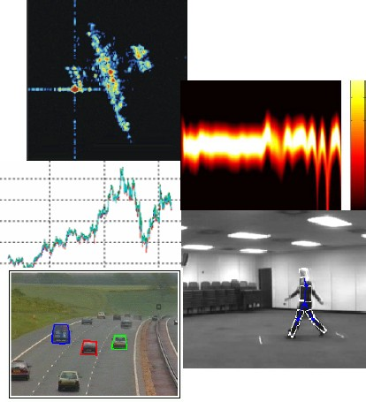
Introduction
State estimation or filtering has many applications
Estimating communication signals from noisy measurements
Predicting economical data
Tracking of aircraft positions from radar
Tracking of people or cars in surveillance videos
Mobile robotics
Module Image - I2S

Slide 6
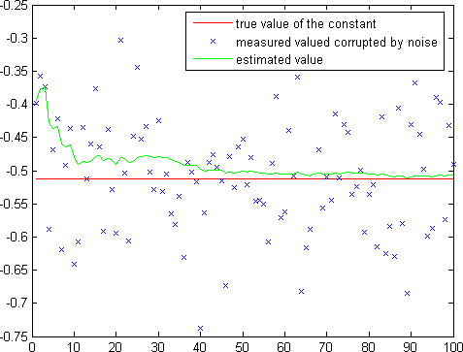
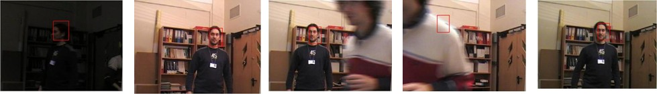
Introduction
Goals of this presentation :
State the problem Introduce the key ideas
Show examples of applications in computer vision
Module Image - I2S

Slide 7
Recall on Estimation Theory
The problem
Find the best estimate xˆ for a parameter x given a set of k measurements
Z_{1:k} = {z₁, . . . , z_{k} }.
State estimation is based on probability theroy.
One of the ’most important’ results in probability theory is Bayes Rule :
P(B|A )P(A )
P(A |B) =
P(B)
_{posterior =} likelihood × prior
evidence
=> simple but powerful !
Module Image - I2S

Slide 8
Introduction
Using Bayes rule, the posterior pdf is given by
p(Z_{1:k} |x)p(x)
p(x|Z_{1:k} ) =
p(Z_{1:k} )
∝ η × p(Z_{1:k} |x)p(x)
p(x|Z_{1:k} ) : the posterior pdf p(Z_{1:k} |x) : the likelihood function p(x) : the prior distribution
"‘The probability of any event is the ratio between the value at which an expectation depending on the happening of the event ought to be computed, and
the value of the thing expected upon its happening."’
Thomas Bayes (1702-1761)
Module Image - I2S

Slide 9
Introduction
Maximum Likelihood Estimation
If we have no prior knowledge about the parameter x :
p(x|Z_{1:k} ) ∝ η × p(Z_{1:k} |x)
Then, the estimate xˆ is given by the value of x which maximizes the likelihood function :
xˆ = arg max p(
Z |x)
ML
1:k
x
Maximum A-Posteriori Estimation
In many cases we have some prior knowledge on x represented by p(x) :
p(x|Z_{1:k} ) ∝ η × p(Z_{1:k} |x)p(x)
Then, the estimate xˆ is given by the value of x which maximizes the posterior distribution :
xˆ = arg max p(Z |x)p(x)
MAP 1:k
x
Module Image - I2S

Slide 10
Introduction
MMSE Estimation
Another key technique for estimating the value of a random variable x is the minimum mean squared error estimation :
xˆ_{MMSE} = arg min E{(xˆ − x)^{T} (xˆ − x)|Z_{1:k} }
ˆx
It is easy to show that :
xˆ_{MMSE} = E{x|Z_{1:k} }
Recursive Estimation
If the measurements are obtained sequentially over time, we could use the previous estimate of x as the prior knowledge.
p(Z |x)p(x
|Z )
p(x|Z_{1:k} ) =
1:k 1:k −1
p(z_{k} |Z_{1:k −1})
Module Image - I2S

Slide 11
Introduction
We can distinguish three estimation problems :
Filtering : estimate the current state x(k ) given all the data availabe up to and including z(k ).
Smoothing : estimate some past value of x(l), l < k , given all the data availabe up to and including z(k ).
Prediction : estimate some future value of x(l), l > k , given all the data availabe up to and including z(k ).
Module Image - I2S

Slide 12



Outline
1
Introduction
Recall on Estimation Theory What Is A Particle Filter ?
Applications in Computer Vision
2
General Bayesian Framework Kalman Filter
3
Particle Filters
Visual Tracking Tracking Methods
Particle Filters Based Tracking
Conclusion
4
5
Module Image - I2S

Slide 13
What Is A Particle Filter ?
Recursive filter
Sequential update of previous estimate
⇒ faster online data processing as opposed to batch processing
Approximate method
It is impossible to obtain analytic solutions to non-linear and non-Gaussian estimation problems
⇒ particle filters provide approximate solutions
Module Image - I2S

Slide 14
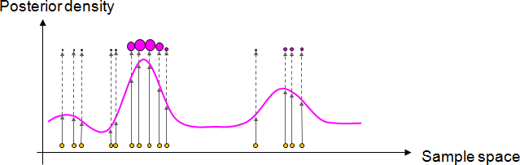
What Is A Particle Filter ?
Particle filter is :
a technique for implementing recursive Bayesian filter by Monte Carlo sampling.
the idea is to represent the posterior density by a set of random particles with associated weights ;
and compute estimates based on these samples and weights
Module Image - I2S

Slide 15



Outline
1
Introduction
Recall on Estimation Theory What Is A Particle Filter ?
Applications in Computer Vision
2
General Bayesian Framework Kalman Filter
3
Particle Filters
Visual Tracking Tracking Methods
Particle Filters Based Tracking
Conclusion
4
5
Module Image - I2S

Slide 16
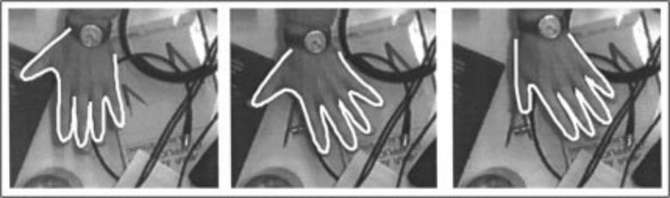
Applications in Computer Vision
Visual Tracking
Particle filters were first introduced to the computer vision community by the famous CONDENSATION paper of Isard and Blake.
⇒ real-time contour tracking
M. Isard and A. Blake, CONDENSATION - conditional density propagation for visual tracking, Int. J. Computer Vision, 29, 1, 5–28, (1998)
A lot of work has been published on contour extraction and tracking since then.
Module Image - I2S

Slide 17
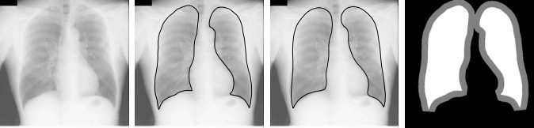
Applications in Computer Vision
Medical Image Analysis
Particle filters have been widely used in medical image analysis
⇒ contour tracking, image segmentation
I. Smal et al., Multiple Object Tracking in Molecular Bioimaging by
Rao-Blackwellized Marginal Particle Filtering, Medical Image Analysis, 12 (6), pp. 764–777, (2008)
M. de Bruijne and M. Nielsen, Shape Particle Filtering for Image Segmentation, in Proc. MICCAI, pp. 168–175, (2004)
Module Image - I2S

Slide 18
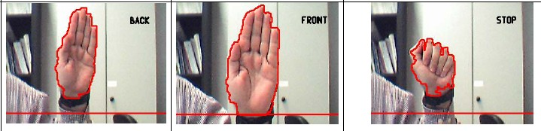
Applications in Computer Vision
Human Computer Interaction
Particle filters are used in HCI for tracking
⇒ face and hand tracking can be coupled with facial expression and gesture recognition
M. Bray et al., Smart particle filtering for 3D hand tracking, in Proc. AFGR, pp. 675–680, (2004)
M. F. Ho et al., A multi-view vision-based hand motion capturing system, Pattern
Recognition, 44 (2), pp ; 443–453 (2011)
Module Image - I2S

Slide 19
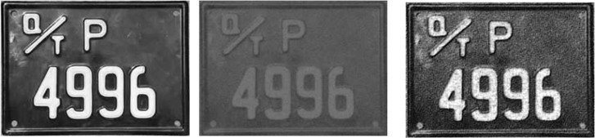
Applications in Computer Vision
Image Restoration
Particle filters have been used for image enhancement and denoising
N. Azzabou, N. Paragios, and F. Guichard, Image Reconstruction Using Particle Filters and Multiple Hypotheses Testing, IEEE Trans. on Image Processing, 19, 5, 1181–1190, (2010)
L. Xia, Image restoration based on particle filters, in Proc. ICSP, pp. 1084–1087,
(2004)
Module Image - I2S

Slide 20
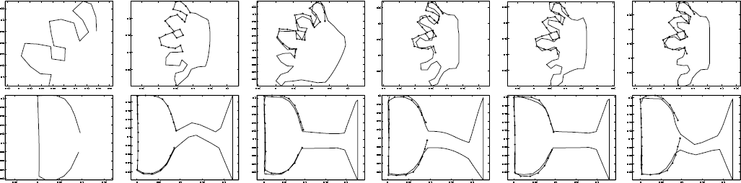
Applications in Computer Vision
Shape correpondence
Particle filters can also be used for shape correspondence
R. Lakaemper and M. Sobel, Correspondences between parts of shapes with particle filters, in Proc. CVPR, pp. 1–8, (2008)
Module Image - I2S
21 / 110

Slide 21
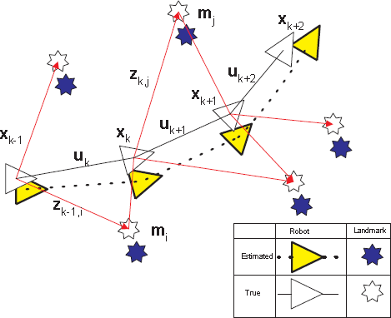
Applications in Computer Vision
Robot Navigation
Particle filters are now used as a key technique for localization and mapping problems in mobile robot navigation.
The Simultaneous Localisation and Map Building (SLAM) problem requires that the probability distribution P(x_{k} ; m|Z_{0:k} ; U_{0:k} ; x₀) be computed for all times k .
S. Thrun, W. Burgard and D. Fox, Probabilistic Robotics, The MIT Press, (2006)
Module Image - I2S

Slide 22
Particle Filters
Why particle filters ?
Kalman filter is limited to linear system with Gaussian noise Extended KF and Unscented KF are limited to Gaussian distributions
Many practical problems show non linear dynamics and non Gaussian noises
We often find multi-modal distributions
Key Idea
Find an approximate solution using a complex model rather than an exact solution using a simplified model.
Module Image - I2S

Slide 23
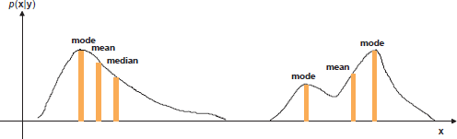
Particle Filters
Muti-modal distribution
A Gaussian distribution is unimodal and verifies : mode = mean = median For a multimodal distribution, the mode, mean and median do not coincide.
=> Kalman Filter, clearly, is not suitable for multi-modal distributions.
Module Image - I2S

Slide 24
Particle Filters (PF) are a family of methods often called : condensation algorithms
sequential Monte Carlo methods bootstrap filters
etc
PF is based on representing the posterior pdf by a set of randomly chosen weighted samples.
"randomly chosen" ≡ "Monte carlo"
Module Image - I2S

Slide 25
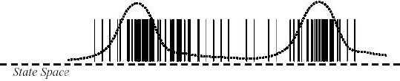
Basic Principle
Represent the pdf as a set of weighted samples
For N → ∞, PF converges (almost
surely) to the true pdf
i
{x } : set of samples.
0:k
i
For N → ∞, PF approaches optimal
{w } associated weights,
k
.
i
Bayesian estimate Regions of high density
Many particles
Large weight of particles
normalized to w = 1
i
k
.
N
i
i
p(x|Z ) = w δ(
x −x )
1:k
k
0:k
0:k
i=1
Module Image - I2S

Slide 26
SIS : Sequential Importance Sampling
The discrete approximation is good if the samples are drawn from the posterior pdf p(x_{k} |Z_{1:k} ).
But we don’t have an explicit representation of p(.) !
K  : we can sample from another importance density q(.).
Our approximation is still correct, up to normalization, if the particles are weighted :
p(x^{i} |Z_{1:k} )
i 0:k
w ∝
k
q(x^{i} |Z_{1:k} )
0:k
We can choose q(.) freely !
Module Image - I2S

Slide 27
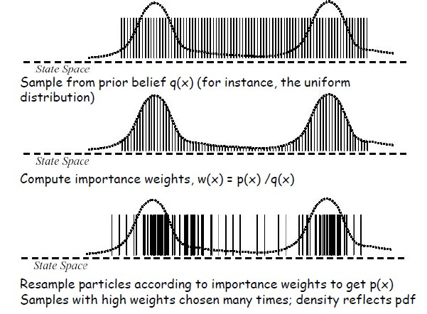
Particle Filters
SIS : Sequential Importance Sampling
Module Image - I2S

Slide 28
SIS : Sequential Importance Sampling
Pseudo-code
A 1 : SIS Particle Filter
i i N
i
N
[{x , w }
] = SIS [{x
, w^{i} } , z_{k} ]
k k i=1
k −1 k −1 i=1
For i = 1 : N
Draw x
i
i
∼ q(x |x , z_{k} )
k
k k −1
Update weights according to
i i i
p(z |x )
p(x |x )
w
i k
∝ w
i
k
k k k −1
k −1
i i
q(x |
x , z_{k} )
k k −1
End For
Normalize weights to
.
N
w^{i} = 1
i=1 k
Module Image - I2S

Slide 29
SIS : Sequential Importance Sampling
Degeneracy problem : after a few iterations, most particles have negligible weights ; the weights are concentrated on a few particles only !
Solutions :
Brute force : many, many samples ! Of course, impractical.
Optimal importance density :
1
2
q(x |x , z ) = p(x |
x , z )
∫
k k −1 k opt
k k −
1 k
j
j i
and w^{i} = w^{i} p(z |x )p(x |x )dx^{j}
k
k k −1 k k k −1 k
But evaluating an integral over the entire state can rarely be done.
i
i
An alternative convenient choice is to take q(x |x
, z ) = p(x |x )
k
k k
k −1 k −1
‹→ easy to implement, but does not take measurements into account.
3
Resampling
Module Image - I2S

Slide 30
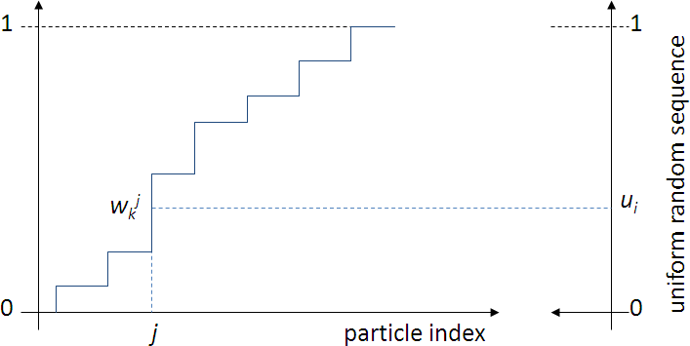
SIS : Sequential Importance Sampling
Resampling : eliminate particles with small associated weights and to concentrate on particles with high weights.
i
Sample N times with replacement from the set of particles {x }
0:k
according to importance weights :
⇒ "Survival of the fittest"
Module Image - I2S

Slide 31
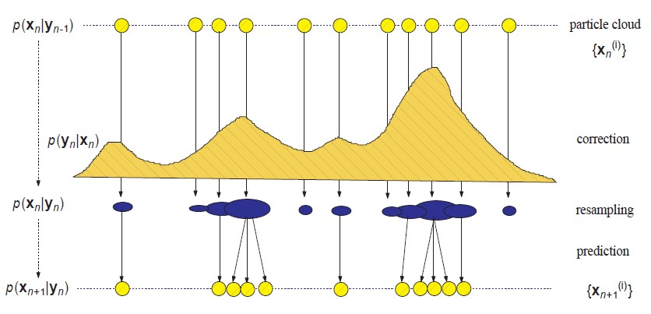
Particle Filters
Sampling and Resampling

Slide 32
Generic Particle Filter Pseudo-Code
A 2 : Generic Particle Filter
i i N i
N
[{x , w }
] = PF [{x , w^{i} } , z ]
k k i=1
k −1 k −1 i=1
k
FOR i = 1 : N
i
i
Draw x ∼ q(x |x , z_{k} )
k
k k −1
i i i
i i
p(z |x )p(x |x )
Update weights according to w ∝
w
k _{k}
k k −1
k k −1
i i
q(x |x ,z_{k} )
k k −1
END FOR
.
N
Normalize weights to w^{i} = 1
i=1 k
Calculate degeneracy measure : N
ˆ
=
.
1
eff N i
(w )
2
i=1 k
ˆ
IF N < N
eff T
Resample
END IF
Module Image - I2S

Slide 33
Estimation form particles
Any estimate of a function f (x_{k} ) can be obtained from the discrete pdf approximation :
N
1
N
.
i i
E[f (x )] =
w f (
x )
k
k k
i=1
.
Mean : E[x ] =
1 N _{w}i _{x}i
k
N i=1 k k
MAP estimate : particle with largest weight
Robust mean : mean within window around MAP estimate
Module Image - I2S

Slide 34
A simple example
We want to estimate a parameter x whose evolution is governed by :
x_{t +1} = 1 + sin(4.10⁻²πt ) + 0.5x_{t} + w_{t} ,
with w_{t} ~ Gamma(3, 2).
We cannot measure x directly but have access to a set of measurements :
.
0.2x² + v_{t} if t ≤ 30
z_{t} =
with v_{t} ~ N(0, σ_{m} ).
t
2 + v if t > 30
,
0.5x_{t} −
t
Module Image - I2S

Slide 35
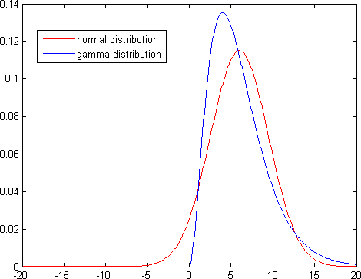
Particle Filters : Example
A simple example
Gaussian and Gamma distributions : same mean and variance.
Module Image - I2S

